Slide 1



Transforming Healthcare through EHR
A Comparative Analysis of Apollo Hospitals vs. Premium Providers
Presented by: Arpit Rastogi, IT Intern – Apollo Hospitals

Slide 2
Agenda
Introduction to Electronic Health Records (EHR)
Role of IT Department
ABDM Initiative
Why Compare Apollo Hospitals with Other Premium Providers?
Overview of EHR Platforms
EHR Adoption Rate
IT Infrastructure
Clinical & Patient Benefits: IT-Driven Outcomes of EHR
How Apollo Outperforms Competitors on Cybersecurity?
Patient Impact
Turning EHR Challenges into Opportunities: Apollo’s IT Playbook
Future IT Roadmap
Summary & Insights: Where Apollo Stands in EHR Innovation
Recommendations for Future EHR Excellence

Slide 3
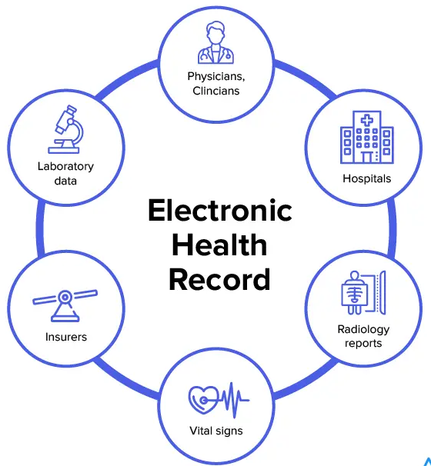
Introduction to Electronic Health Records (EHR)
What is an EHR?
A secure, digital version of a patient’s full medical history — accessible
anytime, anywhere.
Why It Matters to IT:
Powers real-time care through cloud & APIs
Ensures data security, scalability & compliance
Forms the backbone of digital hospitals
Indian Context:
Driven by ABDM (Ayushman Bharat Digital Mission)
Push for interoperability and paperless health records

Slide 4
Why It Matters for IT Teams:
EHRs are not just medical tools—they’re complex IT ecosystems involving :
Cloud-hosted databases for real-time storage & retrieval
APIs to ensure integration with labs, pharmacies, and insurers
Interoperability standards like HL7 and FHIR to talk to other systems.
Security layers to protect sensitive patient data (encryption, audit trails).
IT’s Role in EHR Implementation
☁️AWS / Azure
🔗FHIR & HL7 for System
📱Doctor/Patient Apps (Apollo 24|7)
🔒Encryption + Access Control
🏥Labs, Pharmacies, Imaging Centers
🏛️Sync with Ayushman Bharat Digital Mission
🤖Predictive Alerts, ICU Risk Scoring

Slide 5



India’s Digital Push – ABDM & Apollo’s IT Alignment
What is ABDM?
National digital health mission launched by the Government of India
Aims to create a unified digital health ecosystem
Key features:
Health ID (ABHA): Unique digital ID for every patient
DigiDoctor: Verified registry of doctors
Apollo’s IT Department Role:
Apollo integrated ABHA ID creation into patient registration.
EHR is compliant with FHIR (Fast Healthcare Interoperability Resources) standards.
Developed privacy & consent modules per government standards.
ABHA ID
📱Doctor/Patient Apps (Apollo 24|7)
Health Records
DigiDoctor

Slide 6
Why Compare Apollo Hospitals with Other Premium Providers?
Metric | Apollo | Fortis | Max | MIOT
EHR Adoption Rate | 90% | 75% | 70% | 50%
Cloud Integration | AWS HIPAA | Azure | Hybrid | On-premise
AI Use Cases | ICU, Cards | Radiology | Billing | None
Mobile App Penetration | 80% | 60% | 45% | 20%
Source: Apollo/Fortis Annual Reports (2023), AWS/Microsoft Case Studies, ET Health, NCBI.
Notes:
Source: https://www.apollohospitals.com/apollo_pdf/Annual-Report-FY2023-2024.pdf

Slide 7
📊Overview of EHR Platforms
Metric | Apollo | Fortis | Max | MIOT
EHR Platform Name | Apollo 24 | eICU | Max HealthHub | MIOT e-Hospital
Cloud-Based System | ✅ Yes (AWS) | ❌ Hybrid | ✅ Yes (Azure) | ❌ On-premise
AI Integration | ICU analytics, early alerts | Limited | Clinical alerts | Not available
Mobile App Integration | ✅ 24|7 | App | ❌ No | ⚠️ Partial
API Support (FHIR/HL7) | ✅ Full (Govt. compliant) | ❌ Basic | ⚠️ Partial | ❌ Not disclosed

Slide 8
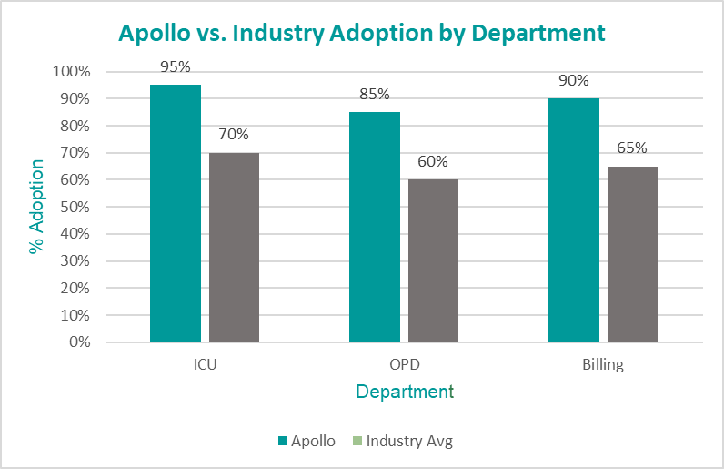
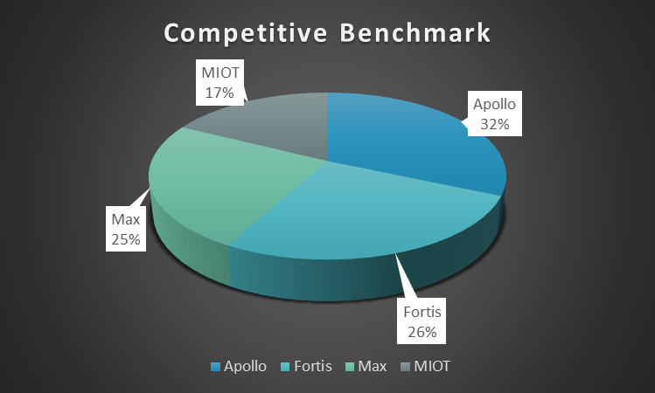
EHR Adoption Rate
Key Impact Metrics:
⏱️ 30% faster OPD wait times
💰 ₹5Cr saved annually
📉 25% fewer prescription errors
Source: Apollo/Fortis Annual Reports (2023), ET Health, NCBI.

Slide 9
IT Infrastructure Behind Apollo’s EHR Ecosystem
Apollo's Core IT Architecture?
Cloud Platform:
Hosted on AWS HIPAA-compliant servers
Ensures 99.9% uptime, real-time backups, and disaster recovery.
Microservices-Based Architecture:
Each module (e.g., OPD, Labs, Billing, Pharmacy) is a separate service
Enables scalability, faster updates, and isolated maintenance.
Mobile Integration Layer:
Syncs data to Apollo 24|7 app and doctor’s dashboard in real-time
🤖Patient Devices & IoT Monitors
Middleware Gateway
Microservices (Labs / OPD / IPD)
Cloud Database (AWS)
Apollo 24|7 App

Slide 10
🚀 Clinical & Patient Benefits: IT-Driven Outcomes of EHR
Outcome Area | Apollo Hospitals (Innovation Leader 🏆) | Premium Hospitals (Industry Avg.)
Prescription Errors | 🔻 30% reduction (AI alerts + auto-validation) | 🔻 10–15% (basic decision support)
Discharge Process Time | ⏳ 20% faster (auto-billing + e-summaries) | ⏳ 5–10% (semi-digital workflows)
Diagnostic Accuracy (AI) | ✅ AI-powered early detection (Cardiac & ICU) | ⚠️ Partial/pilot AI use
Patient Access to Records | 📱 Instant access via Apollo 24|7 | 🔄 Limited or delayed access
Appointment & Lab Flow | 🏆 Seamless digital journey (booking→reports) | ⚠️ Fragmented/manual steps

Slide 11

How Apollo Outperforms Competitors on Cybersecurity?
Apollo's Security Layers
Encryption: "AES-256 Encryption (Highest Standard)"
Access Control: "Biometric + Role-Based Access"
Audit Trails: "Blockchain-Verified Logs"
Compliance: "HIPAA + ABDM Certified"
Feature | Apollo | Fortis | Max
Data Encryption | AES-256 | AES-128 | TLS 1.2
Audit Logs | Blockchain | Manual Spreadsheets | Basic Database
Compliance | HIPAA + GDPR | ISO 27001 Only | None
"In 2023, Fortis suffered a ransomware attack exposing 500K patient records – while Apollo blocked 10K+ attacks with zero breaches.“
Source Link: https://cyberpress.org/breach-of-fortis-healthcare-data/
"Apollo’s cybersecurity tools reduced phishing attempts by 95% (2022-2023)."

Slide 12
Turning EHR Challenges into Opportunities: Apollo’s IT Playbook
Challenges:
Doctor Resistance: "65% of clinicians initially rejected EHR due to complex UI“
Legacy System Migration: "3+ years of patient data stuck in outdated formats“
Interoperability Gaps: "Labs/insurers use incompatible systems”
Apollo’s IT Solutions:
For Doctor Resistance: "Gamified training boosted adoption from 60% → 85% in 6 months"
Legacy Migration: "Phased data mapping cut errors by 40% (No downtime)"
Interoperability: "FHIR APIs integrated 50+ external partners"

Slide 13
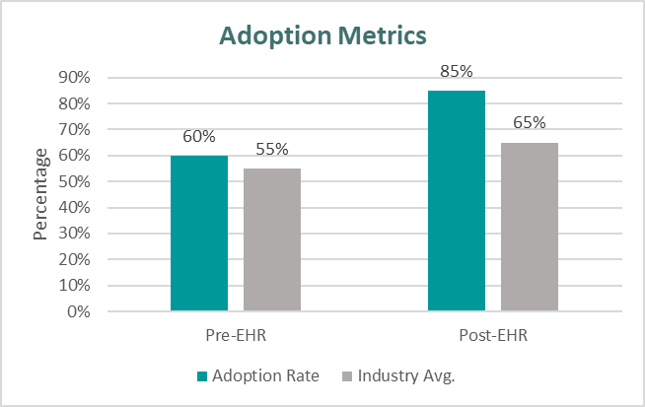
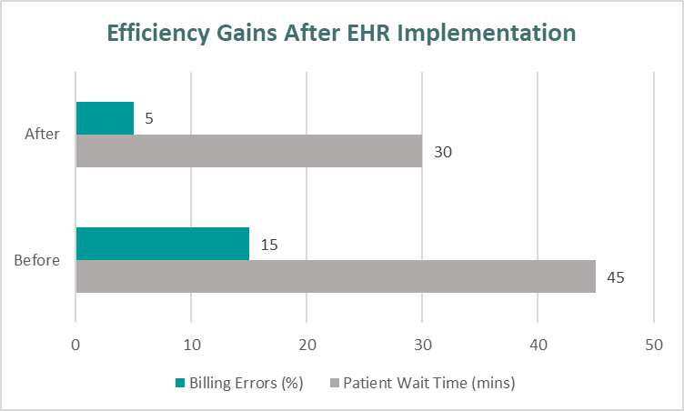
EHR Adoption & Efficiency Gains: Apollo's Digital Leap
Higher clinician adoption (process change):
Efficiency Gains:
Pre-EHR (2022) → Training Phase → Post-EHR (2023)
Source: https://www.apollohospitals.com/annual-reports/ https://www.pwc.in/industries/healthcare.html
Source: Apollo Hospitals Internal Audit Report, 2023; Economic Times HealthTech Insights, 2023.

Slide 14
The Future of EHR – Apollo’s IT Roadmap
Innovation Area | Details
Voice-Enabled EHR | Doctors use voice commands (e.g., via Amazon Alexa APIs) to retrieve/update patient records
AI-Powered Clinical Decisions | Apollo developing AI modules to suggest treatments based on symptoms & history
Blockchain for Data Sharing | Expanding blockchain from audit logs to multi-hospital patient record exchange
Patient-Doctor Chatbots | 24/7 AI-based medical assistant integrated into Apollo 24
Interoperability with ABDM | Full-scale alignment with Ayushman Bharat Digital Mission through open APIs

Slide 15
Summary & Insights: Where Apollo Stands in EHR Innovation
✅ Key Summary Points:
Apollo Leads the Pack:
Highest EHR adoption rate (90% of departments)
Strong cloud-native architecture (AWS + HIPAA compliant)
End-to-end digital patient journey via Apollo 24|7
Advanced AI integration (especially in ICU, cardiology)
Security & Interoperability
Blockchain-backed data audits
Full FHIR integration for ABDM alignment
Zero major breaches in recent years
Competitor Landscape
Max and Fortis are progressing in cloud + mobile integration
MIOT still relies on older, local systems with minimal AI or API capability

Slide 16
Recommendations for Future EHR Excellence
✅ For Apollo Hospitals:
ABDM Integration
Fully align with Ayushman Bharat Digital Mission using advanced FHIR APIs
Enable seamless patient data sharing across public and private networks.
Scale AI Modules Across Departments
Expand predictive analytics beyond ICU to oncology, emergency, and chronic care
Collaborate with startups or in-house teams for AI innovation
Continuous IT Training & Feedback Loops
Internal IT teams and clinicians must receive regular training on AI-EHR updates
Gather real-time user feedback to refine workflows

Slide 17
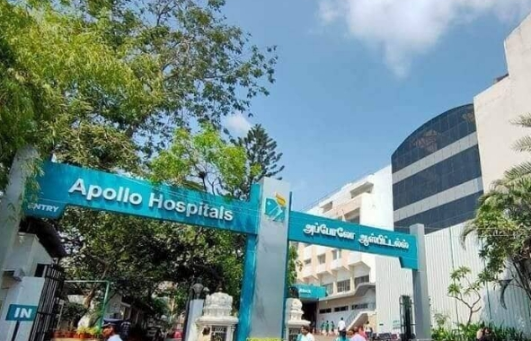
THANK YOU
Source: https://docs.google.com/document/d/19y_3V3896o42y--l65WTxO7QbrjyV_gA/edit?usp=sharing&ouid=109445018799605602524&rtpof=true&sd=true

